Slide 1
Data Structure Algorithm
Section 11 – binary heap

Slide 2
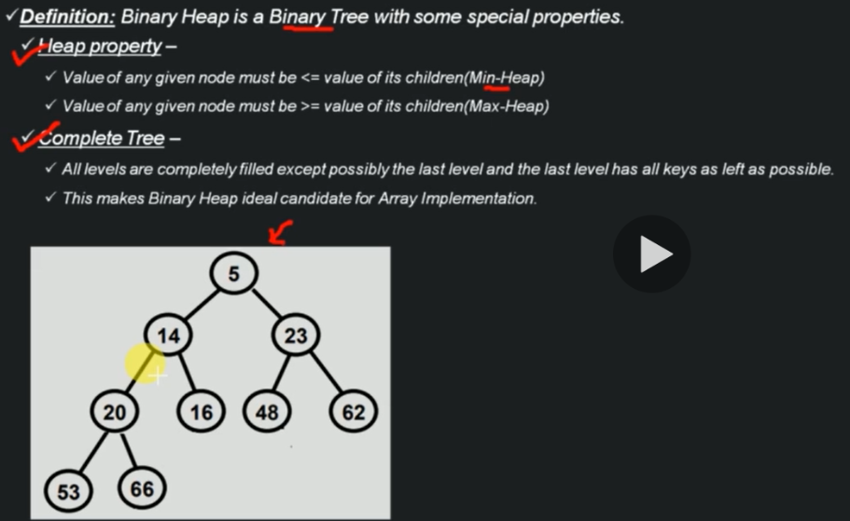
What is Binary Heap

Slide 3
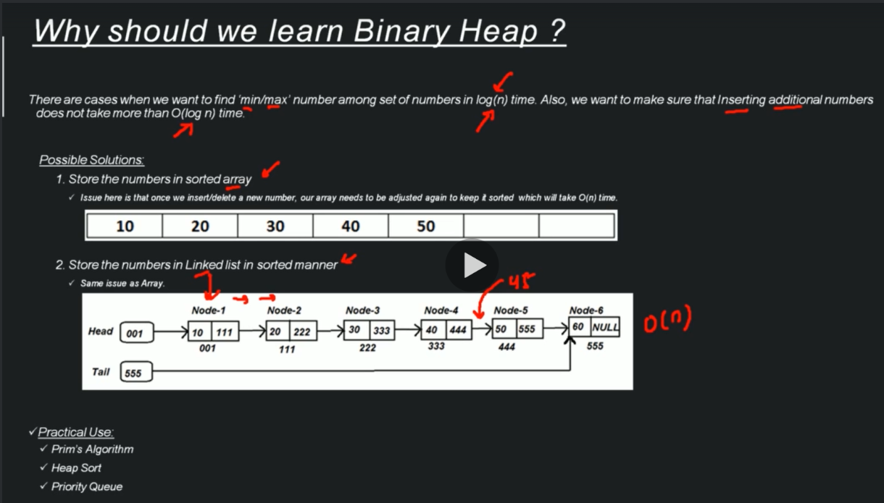
Why should we learn Binary Heap?

Slide 4
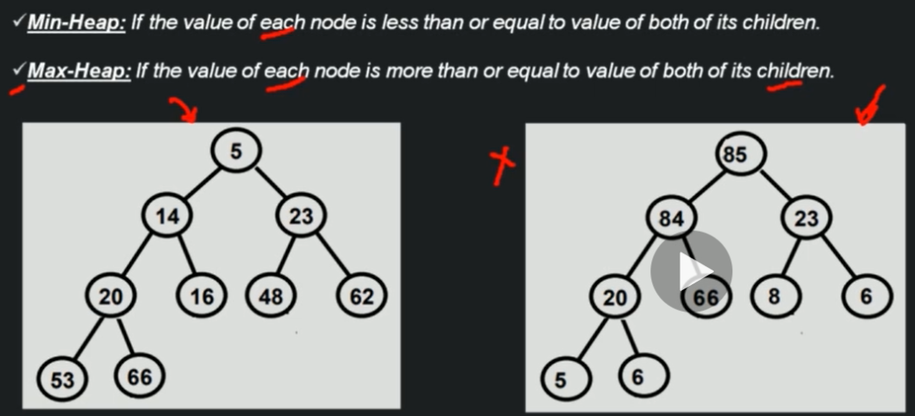
Types of Binary Heap

Slide 5
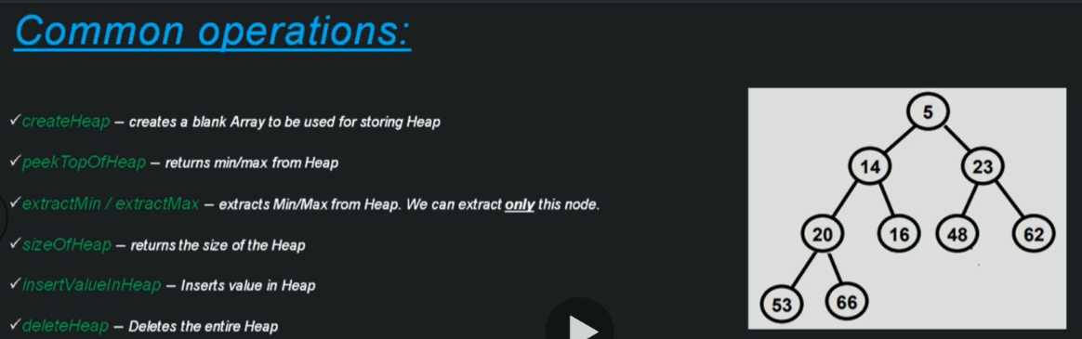
Common operations

Slide 6
Implementation Options
Array based Implementation
Reference/Pointer based Implementation
Binary Heap use the same way to implement using array. Remember Binary Heap is one Binary Tree but it has some properties. Next slide recap this concept.

Slide 7
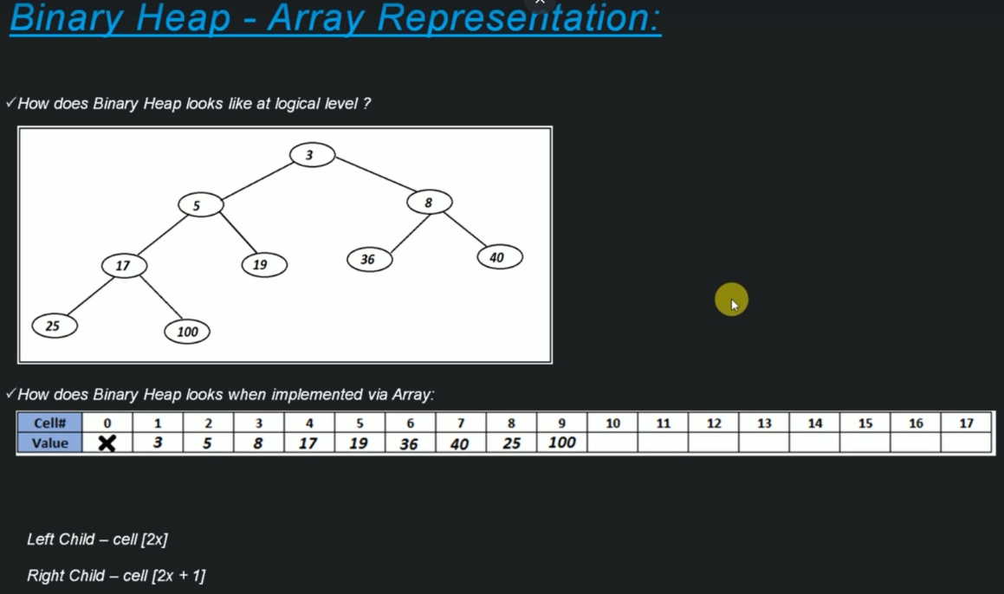
Implementation Options

Slide 8
Creation of Heap - Array Implementation
createHeap(size)
create a blank array of 'size + 1'
initialize sizeOfHeap with 0
-------------------------------------------------------------------------------
Time & Space Complexity - Creation of Heap:
createHeap(size)
create a blank array of 'size + 1' -------------------------------- O(1)
initialize sizeOfHeap with 0 -------------------------------------- O(1)
Time Complexity - O(1)
Space Complexity - O(n)

Slide 9
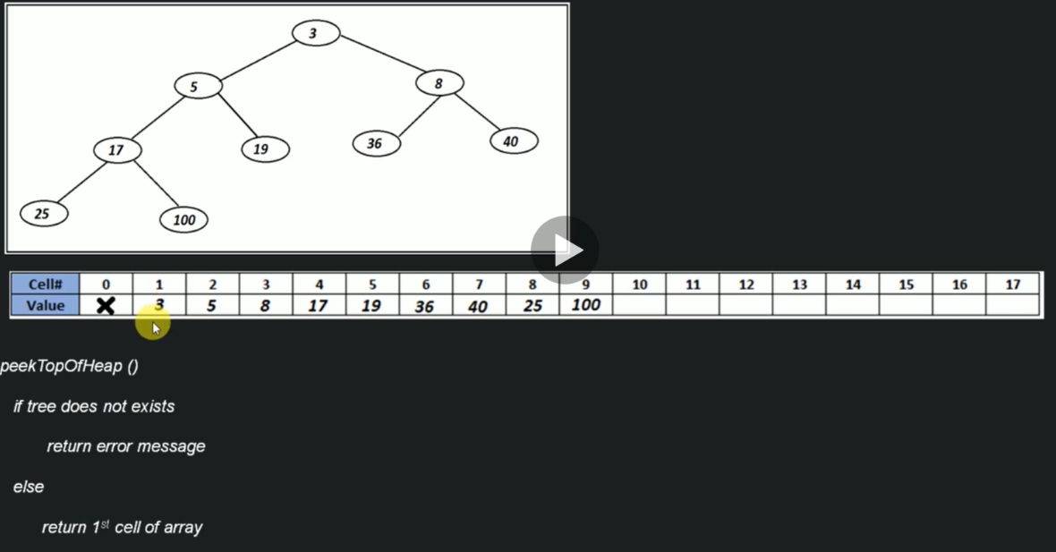
Peek of Heap

Slide 10
Peek of Heap
Time Complexity - Peek of Heap
peekTopOfHeap()
if tree does not exists -------------------------------------- O(1)
return error message --------------------------------------- O(1)
else --------------------------------------------------------- O(1)
return 1st cell of array ----------------------------------- O(1)
Time Complexity - O(1)
Space Complexity - O(1)

Slide 11
Size of Heap
sizeOfHeap()
return sizeOfHeap
Note: In this case you don't return the size of array. You return the quantity of cells filled.

Slide 12
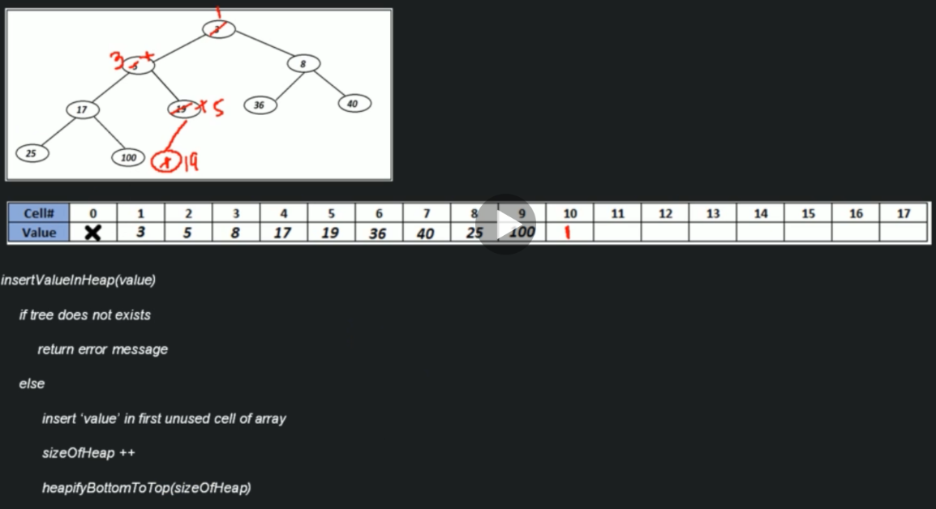
Insertion in Heap

Slide 13
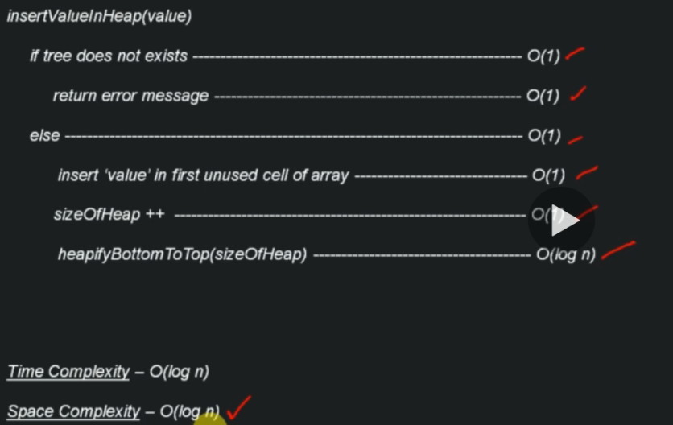
Time & Space Complexity – Insertion in Heap

Slide 14
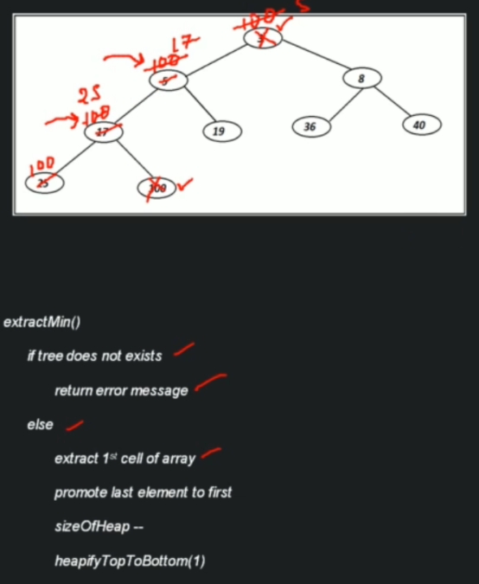
Extract Min from Heap

Slide 15
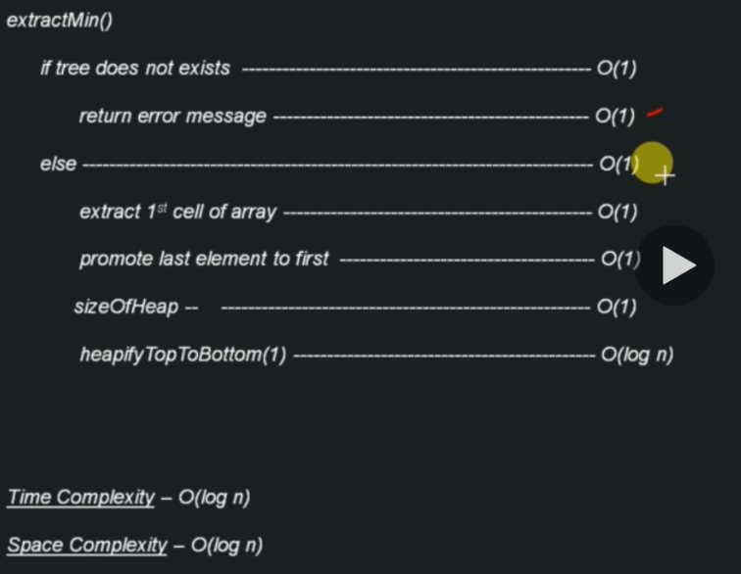
Time Complexity – Extract Min from Heap

Slide 16
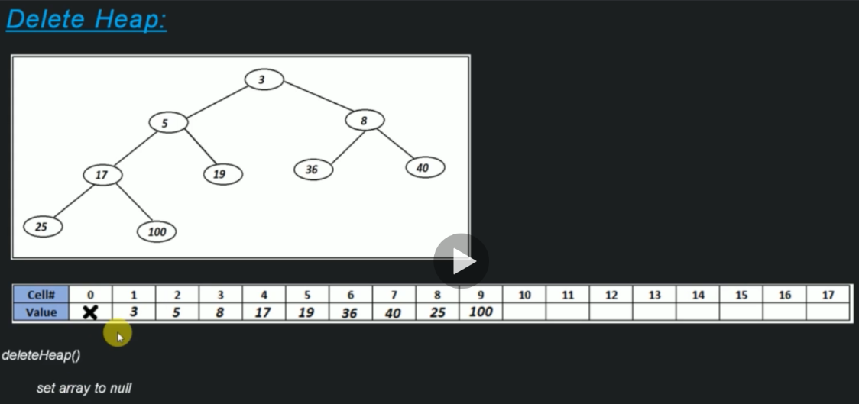
Delete Heap

Slide 17
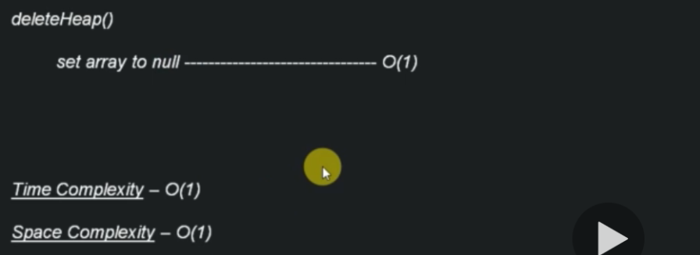
Time & Space Complexity – Delete Heap

Slide 18
Why Avoid Reference Based Implementation
It's very advised implement Binary Heap using Array. Because when you need to extract/delete one node you do in O(log n) time. When you delete you have to get the last element and add at the position that you want to delete. In this case, you get the last element get the last cell in the array in O(1) time. But when you do this using LinkedList you have to traverse the LinkedList and you gonna expend O(n) time. You spend more time.
For this reason, use array to implement Binary Heap.

Slide 19
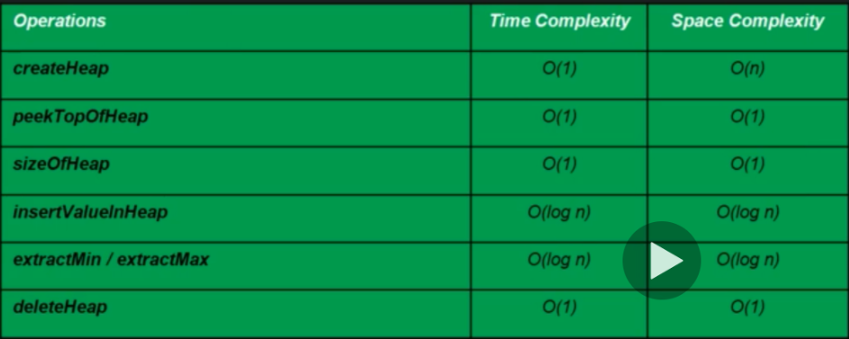
Time & Space Complexity of Heap operation (Array Implementation)

Slide 20
Data Structure Algorithm
Section 12 – Trie

Slide 21
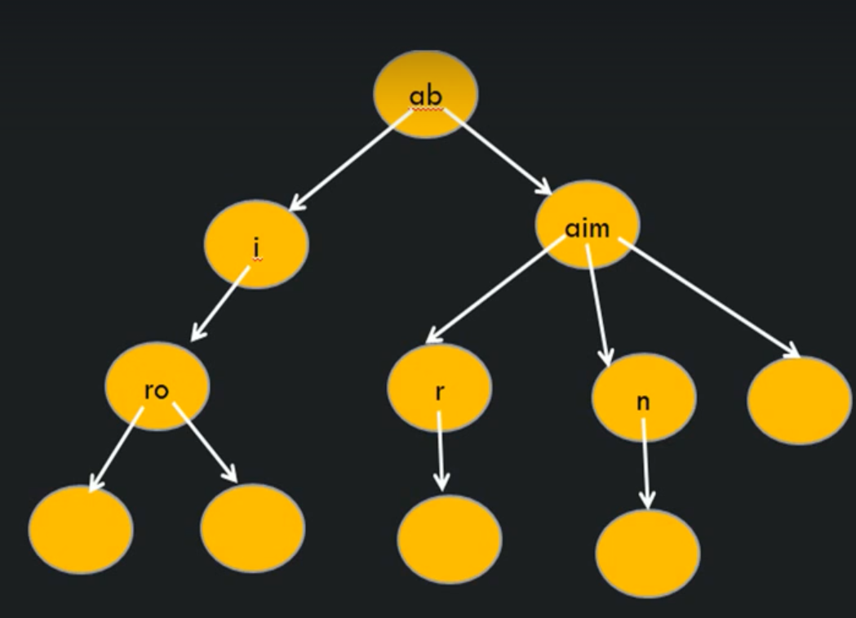
What & Why of Trie?
What is Trie?
Is it search tree, which is typically used to store/search strings in space/search strings in space/time efficient way.
In it, any node can store non repetitive multiple character/s.
Also, every node stores 'links' of next character of string.
Also, every node keepsa track of 'end' of String

Slide 22
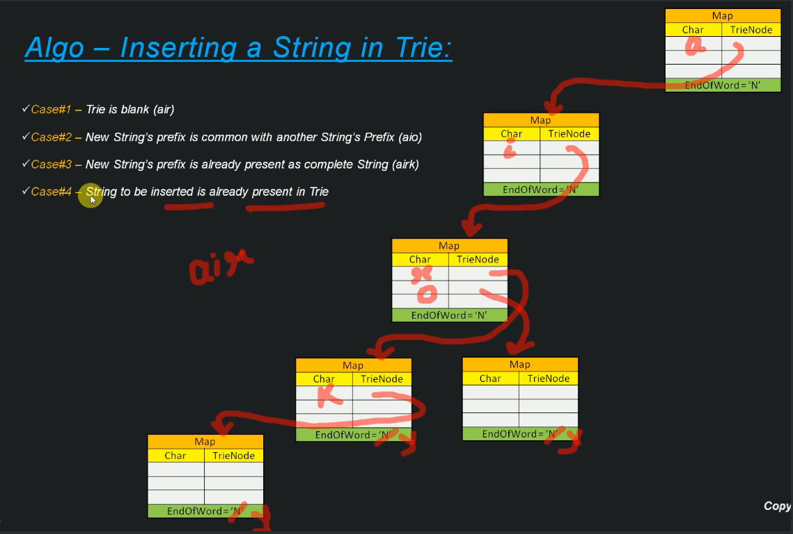
Algorithm – Inserting a String in Trie

Slide 23
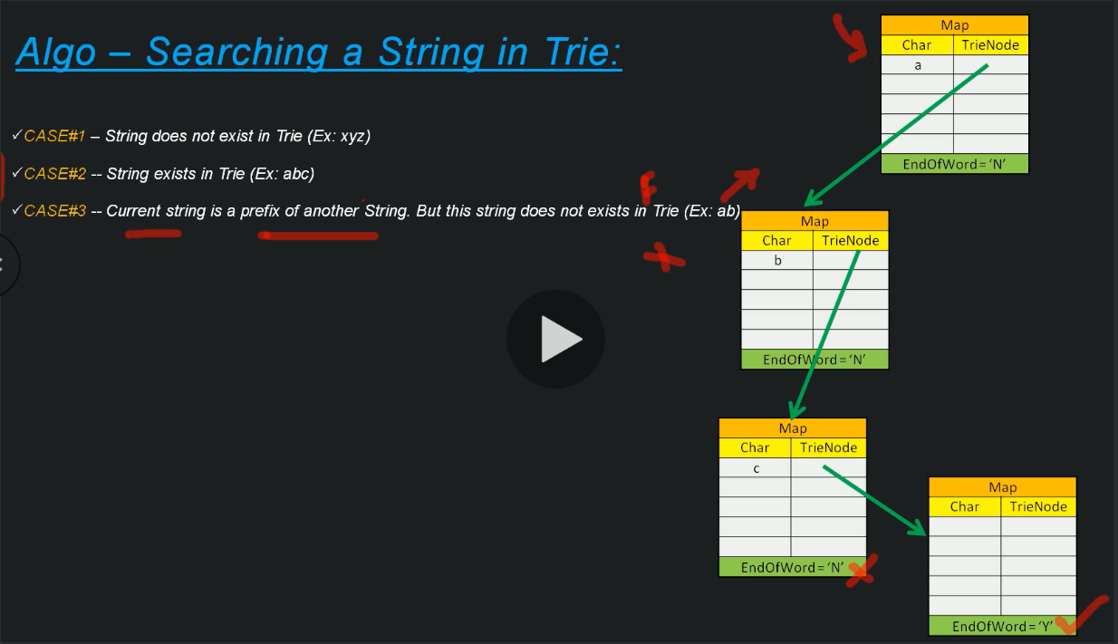
Algorithm – Searching a String in Trie

Slide 24
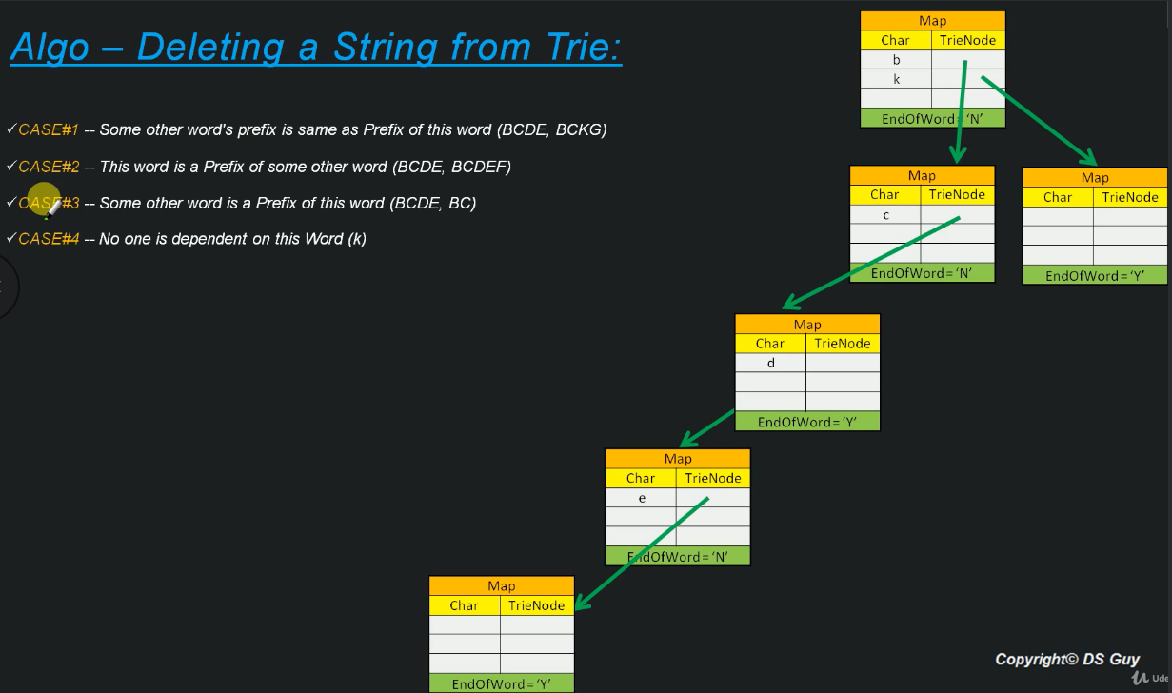
Algorithm – Deleting a String in Trie

Slide 25

Trie – Practical Use

